Slide 1



JOSM in detail
Dar es Salaam, Tanzania

Slide 2
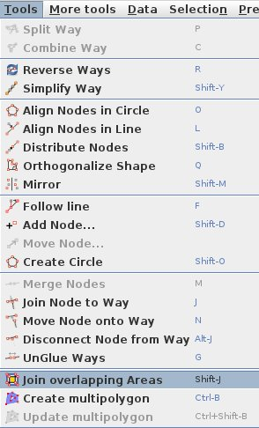
JOSM in Detail
JOSM has some additional tools to make it easier to draw lines and shapes. These tools are found in the Tools menu at the top of JOSM.

Slide 3
Advanced Editing Tools
Split Way
Combine Way
Reverse Way
Simplify Way
Create Circle OR Align Nodes in Circle
Orthogonalize Shape
Unglue Ways

Slide 4
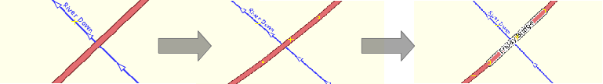
Split Way
This allows you to divide a line into two separate lines. Useful if you want to add different attributes to different parts of a road, such as a bridge. To use this function, select a point in the middle of the line that you want to split, go to Tools ‣ Split Way and your line should be split in two.

Slide 5
Combine Way
This does the opposite of Split Way. To combine two lines into a single line, they must share a single point. To use this function, select both lines that you want to combine.
You can select more than one object by holding the SHIFT key on your keyboard and clicking on each line.

Slide 6
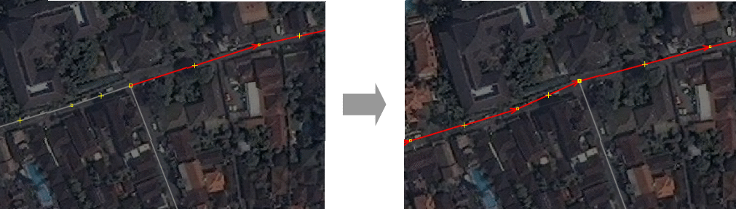
Combine Way
Combine Way
Combine Way
When you have selected both lines, go to Tools ‣ Combine Way.

Slide 7
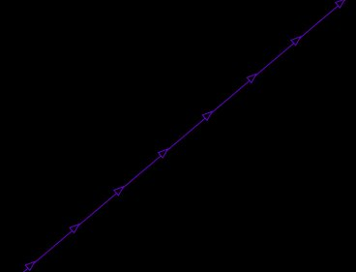
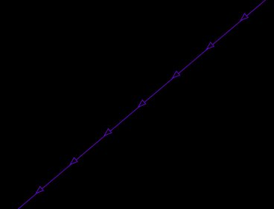
Reverse Way
This will change the direction of the line. If the line incorrectly represents a road or river that is one-way, you may want to change its direction. To Reverse Ways select the way, then go to Tools ‣ Reverse Way

Slide 8

Simplify Way
If your line has too many nodes in it and you’d like to make it simpler, this will remove some of the points from a line. Select the way, then go to Tools ‣ Simplify Way

Slide 9
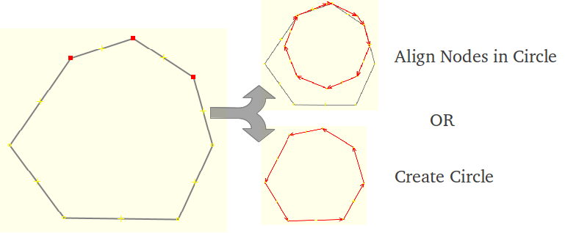
Align Nodes in Circle OR Create Circle
If you are trying to make a circular shape, draw the circle as best you can and then select three nodes and the function. It will help arrange your points in a circle. Select the way then go to Tools ‣ Align Nodes in Circle OR Select at least three nodes then go to Tools ‣ Create Circle

Slide 10
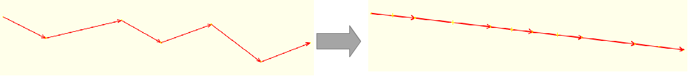
Align Nodes in Line
This function will align a series of points into a straight line. With long lines it is best to select sections of the line to straighten. Be careful as this does have the tendency to shift the line a little. To do this, select the line then go to Tools ‣ Align Nodes in Line

Slide 11
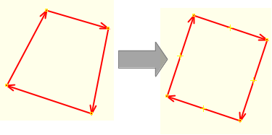
Orthogonalize Shape
This function is very useful for drawing regular shapes such as buildings. After you draw an area, this function will reshape it to have square corners. This feature is most useful for other regularly shaped features, such as tennis courts or landuse areas. To do this, select the object then go to Tools ‣ Orthogonalize shape or simply press the shortcut Q

Slide 12
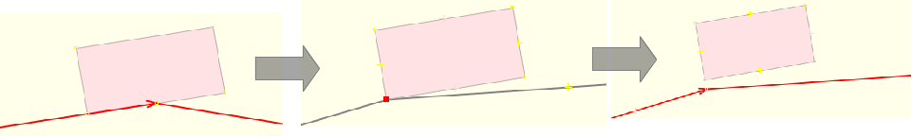
Unglue Ways
This tool allows you to detach nodes that are connected. To do this, select either a node or one of the ways glued together, then go to Tools ‣ Unglue Ways

Slide 13
Plugins
JOSM allows you to install numerous plugins, which add extra functionality to the software.
Installing plugins
Buildings plugin
mbtiles
Utilsplugin2 (More Tools)

Slide 14

Install plugins
To install plugins to Edit > Preferences and click on the Plugins tab.
You will see a list of available plugins.
To install a plugin you simply must check the box next to it and click OK at the bottom.
Lastly, you must restart JOSM anytime you install new plugins.

Slide 15
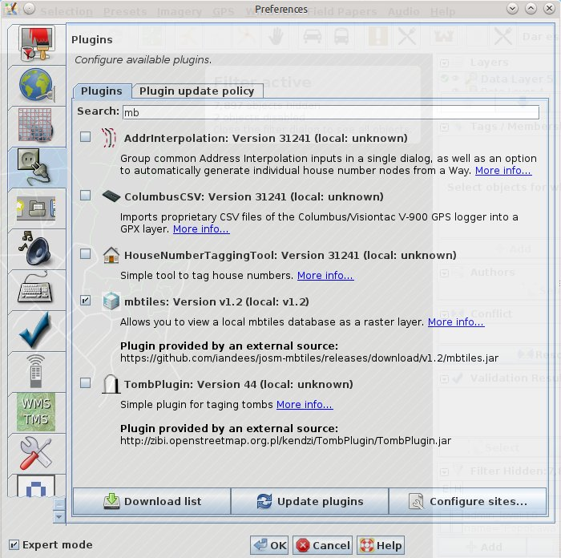
Install plugins

Slide 16

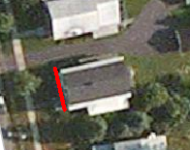
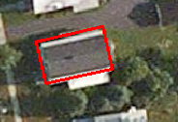
Building plugin
Buildings_tools is simple plug-in for drawing rectangular buildings.
This plugin is by far one of the most useful tools for editing. After installation, It will appear as an icon on the left.
The Building tool allows you to create shapes with 90 degree corners with just three clicks. First, trace the edge of the building and then drag out the line to make it a polygon.

Slide 17
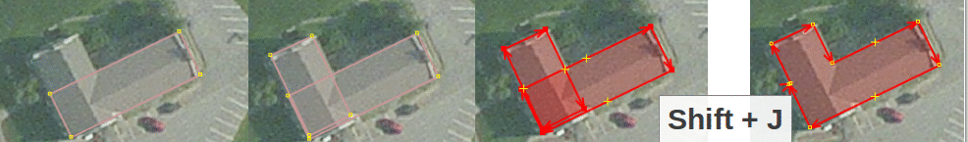
Join overlapping Layers
You can also create more complicated buildings by using the merge option. Create your building outline, select all of the polygons (press SHIFT to highlight them all) and then press SHIFT + J to merge the objects.

Slide 18
mbtiles
The mbtiles plugin allows you to view a local mbtiles database as a raster layer.
To install mbtiles, go to Edit > Preferences>Configure Plugins
Search for mbtiles, check the box on the left and click ok
You must restart your computer for the plugin to be active

Slide 19
Install plugins

Slide 20
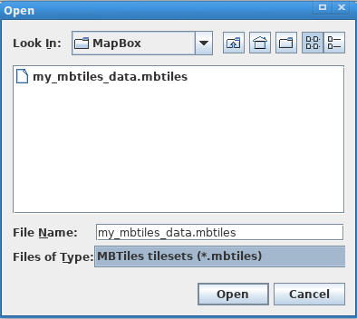
mbtiles
To use mbtiles in JOSM
Go to File > Open > "Files of Type" drop down list to select the "MBTiles tilesets(*.mbtiles)" file type.
Pick your tileset.
Use the Layers window to turn the images on and off just like any other imagery layer.

Slide 21
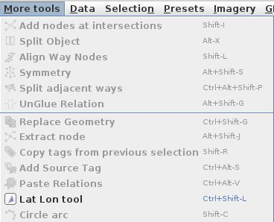
utils plugin 2
The plugin utilsplugin2 has several features that are also useful for editing.
After you install this plugin, a new menu will appear called More Tools.
Some of the most useful tools here are:
Add Nodes at Intersections
Copy Tags from Previous Selection
Replace Geometry

Slide 22
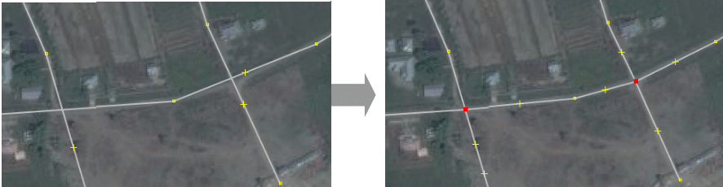
Add Nodes at Intersections
This tool is helpful for adding missing nodes in intersections of selected ways. It is good practice that roads and rivers should always have common nodes where they intersect. Select all the ways, then go to More Tools ‣ Add nodes at intersection

Slide 23
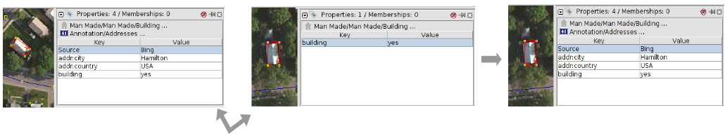
Copy Tags from Previous Selection
This function makes copying tags easier. If you want to create many objects with the same tags, first draw the objects. Then add the tags to one object. Click on another object and press Shift + R to copy the tags from the previously selected object. You can do this for all objects that you want to tag.
Note that the tags will be copied from the previously selected object.

Slide 24
Replace Geometry
This tool is to redraw a poorly shaped object, when you want to keep the history, attributes and ID number of that object.
For example, if you come across a building that is complicated and drawn in a poor fashion, then instead of painfully changing each node, you can just draw the object again select the old and new object press More Tools ‣ Replace Geometry to transfer all the information over.

Slide 25
JOSM Filters
JOSM Filters allow you to disable, hide, select, and highlight specific groups of objects based on flexible custom parameters.
To work with filters, turn on the filters panel (Windows→Filter from the menu, or Alt+Shift+F from the keyboard). Use the +Add button on this panel to create a new filter. The filter creation window looks like this:

Slide 26
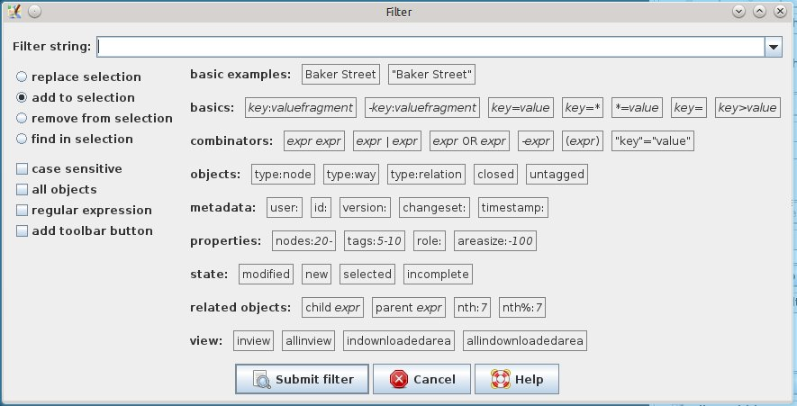
JOSM Filters

Slide 27
JOSM Filters
For example, to filter the data layer to show only roads: Add the following filter
highway=*
then click on Submit Filter

Slide 28
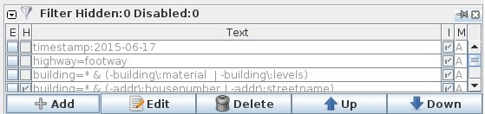
Filter Options
E (Enable): Enable or disable this filter line.
H (Hide elements): If this option is ticked, the chosen objects are completely hidden. Otherwise they are disabled and shown in a shade of gray.
Text: The search term or property that defines the objects that are filtered.
I (Inverse Filter): Normally, the specified objects are hidden and the rest is shown. If this option is activated, only the specified objects are shown and the rest is hidden.

Slide 29
Quality Assurance
As you map more and more it is crucial to learn the “proper” way to do things.
JOSM has a validation tool, which is automated to search for errors and warnings in your data.

Slide 30
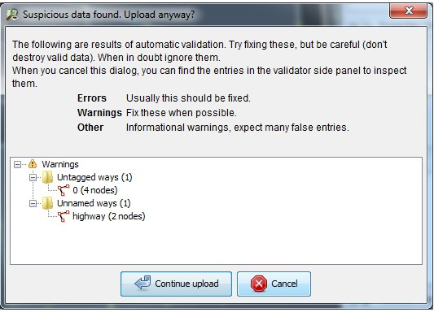
Errors and warnings
Sometimes when you go to upload your edits in JOSM you get a pop-up window like this:

Slide 31
Errors and Warnings
Errors: These are important to fix, and therefore usually you should not ignore these. Examples of errors include duplicated objects or overlapping lines and polygons.
Warnings: These are problems that are important to fix, but in some cases, they are tolerable.
NOTE: When you run the validation tool, you may get a very long list of errors and warnings. This is because the validation tool works on the whole map, not only the changes that you have made. You may see mistakes that other mappers have made, and you can fix them, or ignore them.

Slide 32
Common validation warnings
Ways that are not closed
Crossing buildings (overlapping buildings)
Untagged nodes or ways
End node near another way
Crossing ways

Slide 33
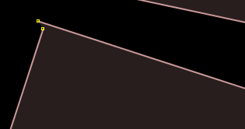
Ways that are not closed
This is usually a line that does not form a polygon. Common examples are buildings where the first node does not meet the last node.
To fix this, select both nodes and go to Tools ‣ Merge Nodes to connect them.

Slide 34
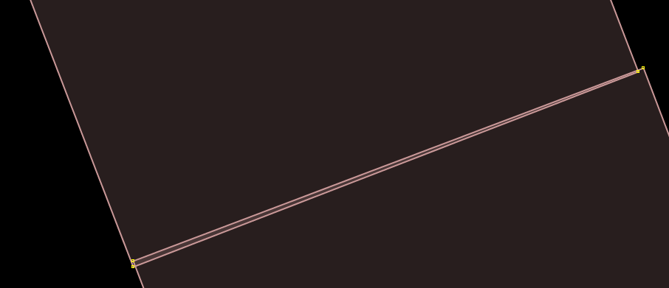
Crossing buildings (overlapping buildings)
This means that buildings are overlapping each other.
To fix this, move the nodes of one of the buildings outside of the other building. It is possible for two buildings to share nodes, if the buildings share a common wall. But two buildings cannot overlap with one another.

Slide 35
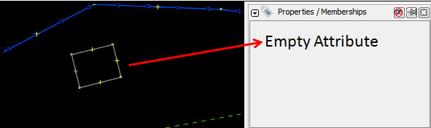
Untagged nodes or ways
If someone draws a point or a line but forgets to give it any tags, then it is useless, because it does not mean anything.
To fix this, apply tags to the object to identify it, or delete it if it is a mistake.

Slide 36
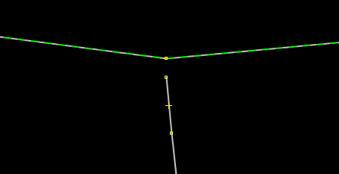
End node near another way
If a line ends very close to another line but does not connect, this raises a warning.
Many times this warning is not important, but it helps to find road intersections that are supposed to connect but do not.

Slide 37
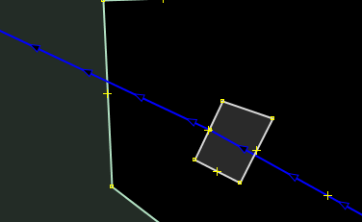
Crossing ways
Lines that cross other lines without being connected will raise warnings. Many times this is not a problem, because the crossing ways are intentional - such as in the case of bridges, or streets and rivers that cross landuse polygons. However, it is sometimes helpful to find errors.

